Slide 1
Universal Relation
3/4/19

Slide 2
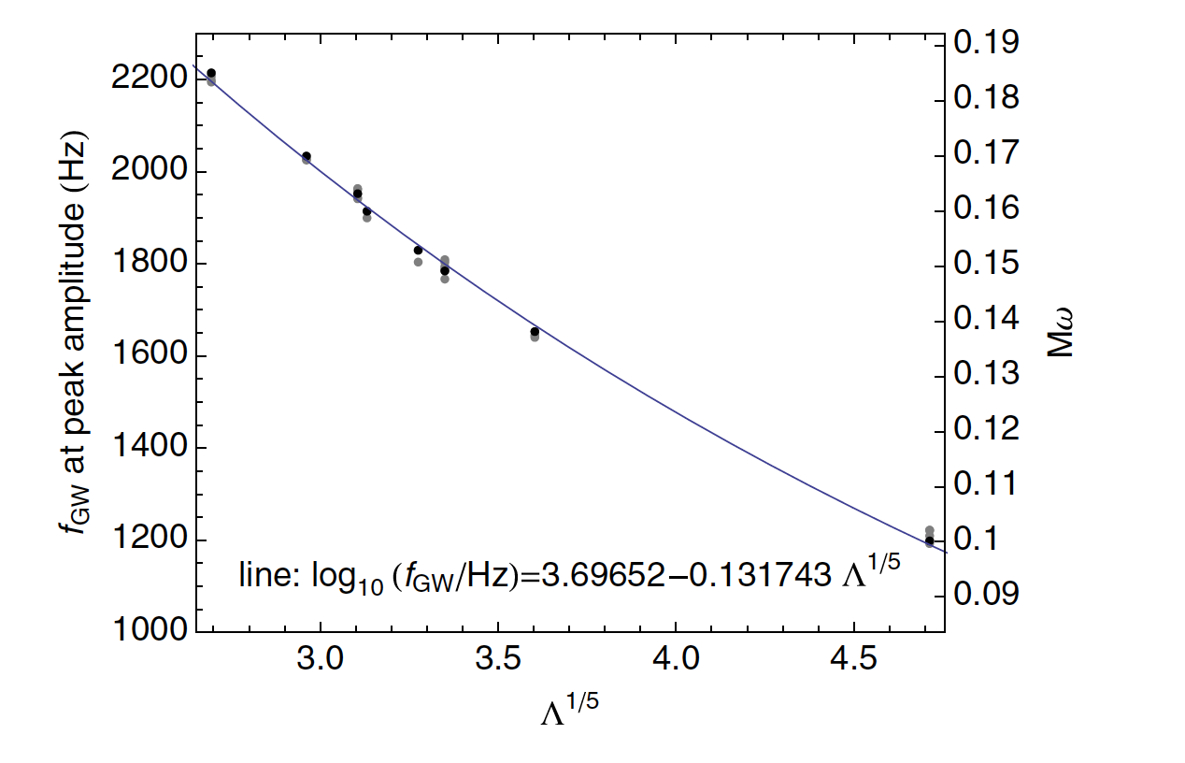
Read et. al. 2013

Slide 3
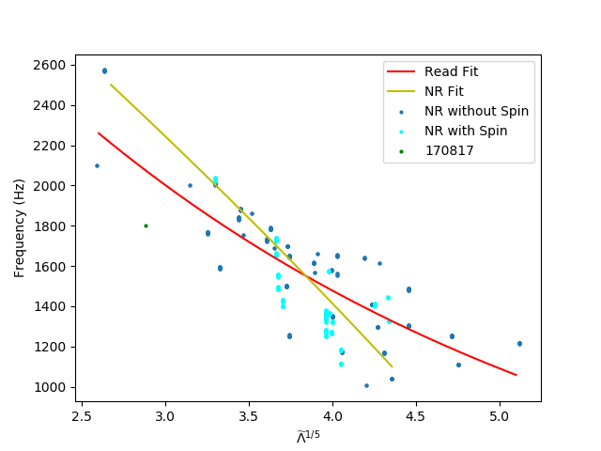
CoRe Database NR Waveforms

Slide 4
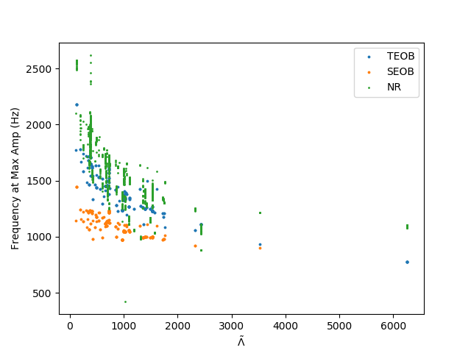
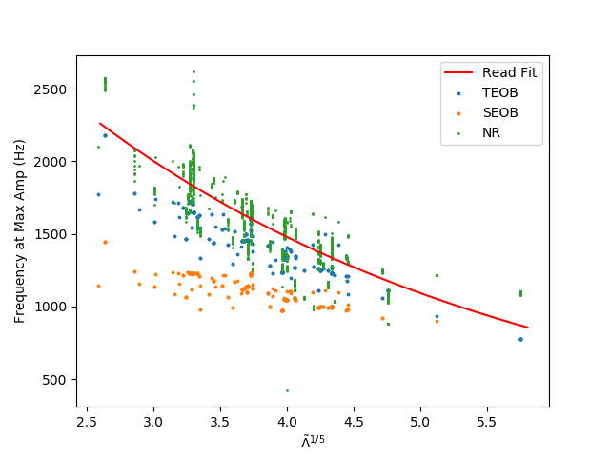
SEOBNRv4T & TEOBResum & CoRe NR

Slide 5
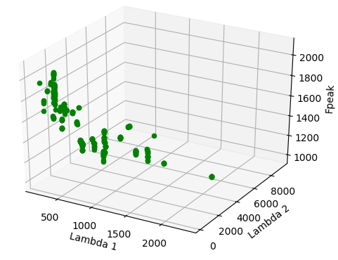
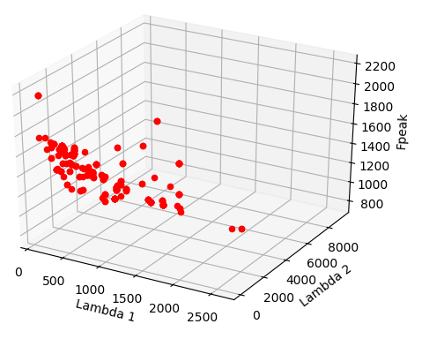
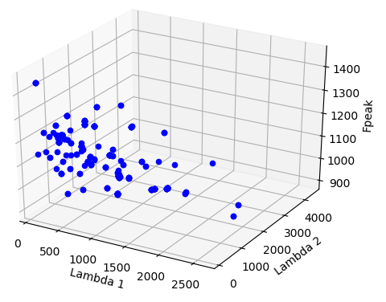
Is there a 3D surface?
NR
SEOB
TEOB

Slide 6
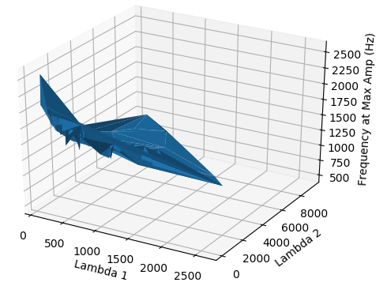
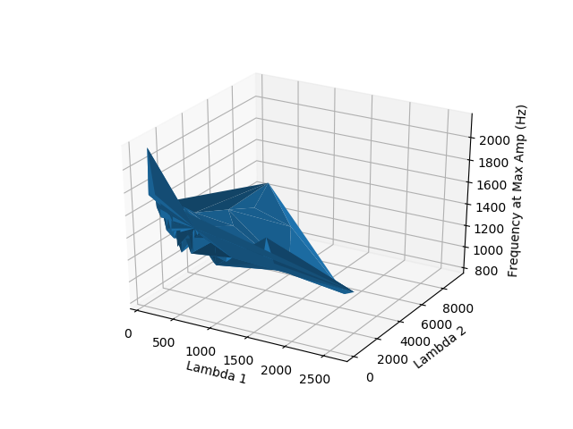
Is there a 3D surface?
NR
TEOB
SEOB

Slide 7
Group Meeting Update
3/5/19

Slide 8
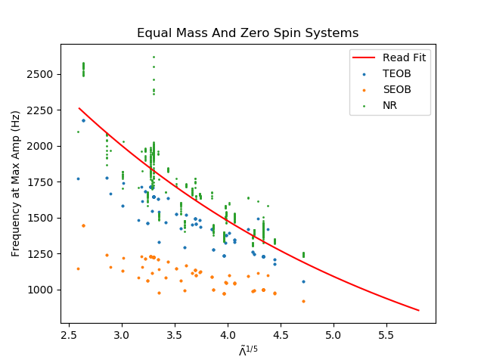
Duplicity in Combined Deformability and Fpeak

Slide 9
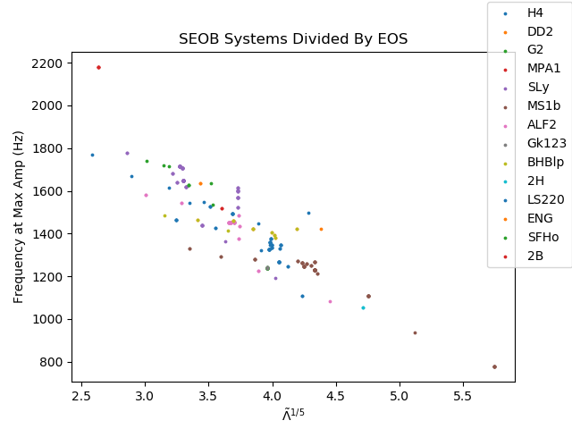
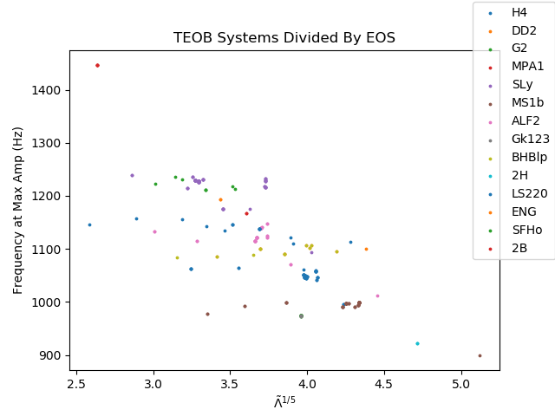
Duplicity in Combined Deformability and Fpeak

Slide 10
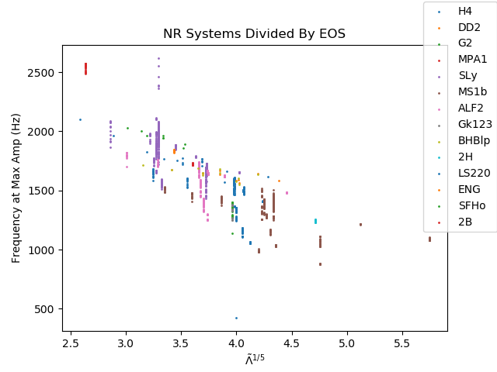
Duplicity in Combined Deformability and Fpeak

Slide 11
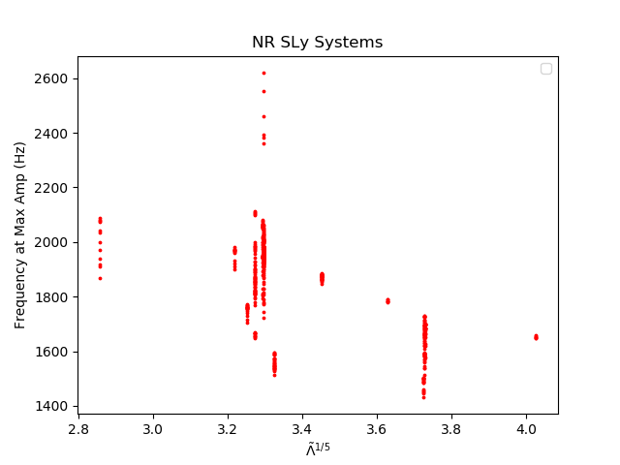
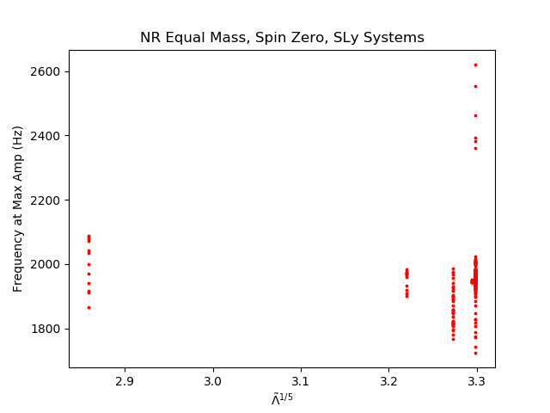
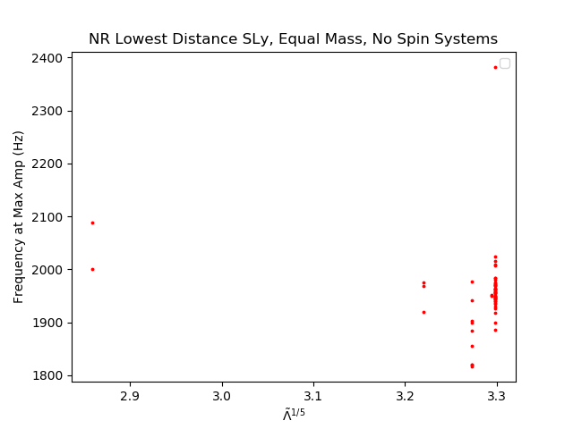
Duplicity in Combined Deformability and Fpeak

Slide 12
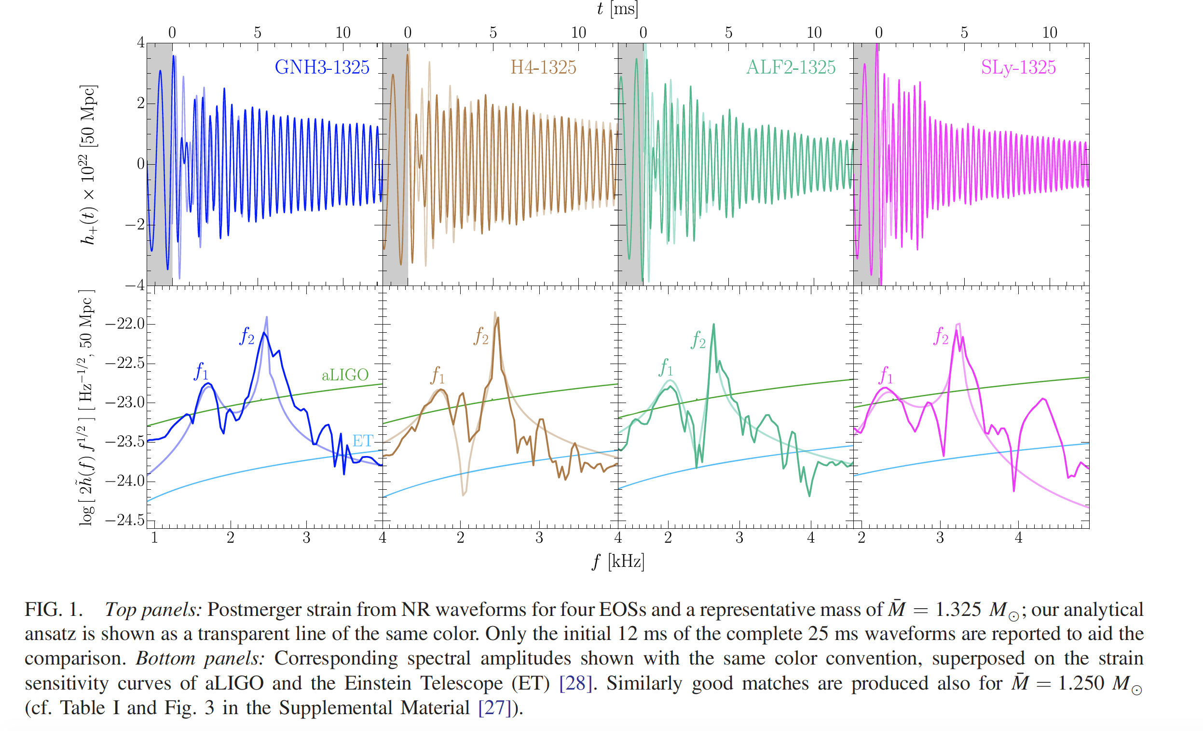
Post Merger in Frequency Domain

Slide 13
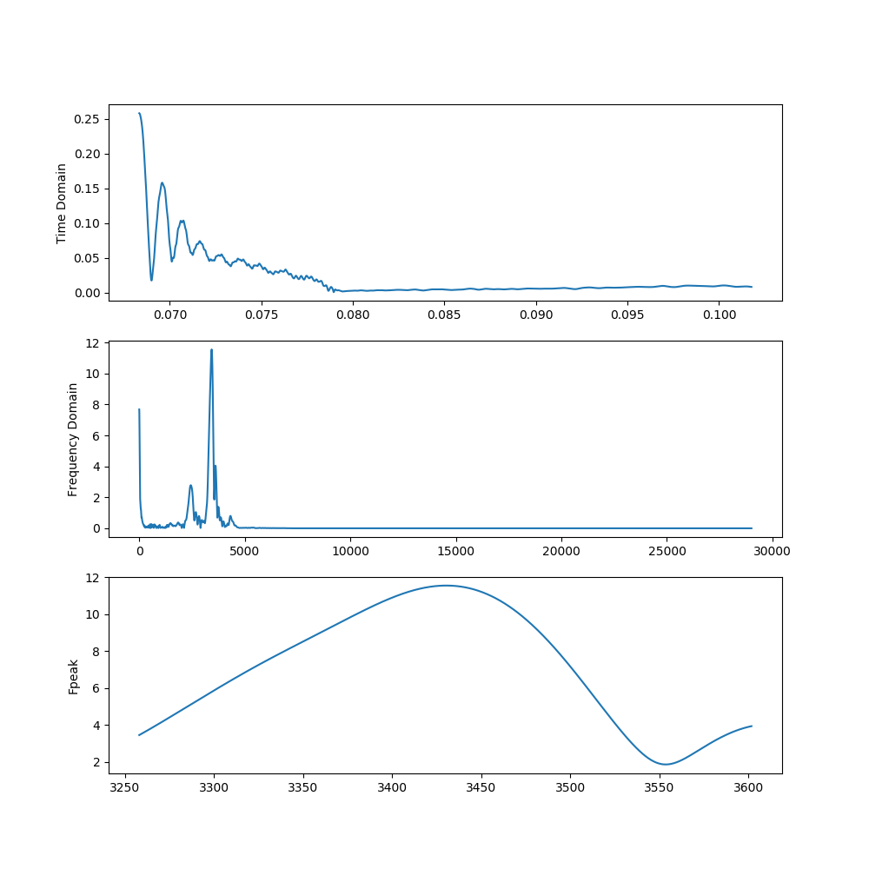
Post Merger in Frequency Domain

Slide 14
Update
3/6/19

Slide 15
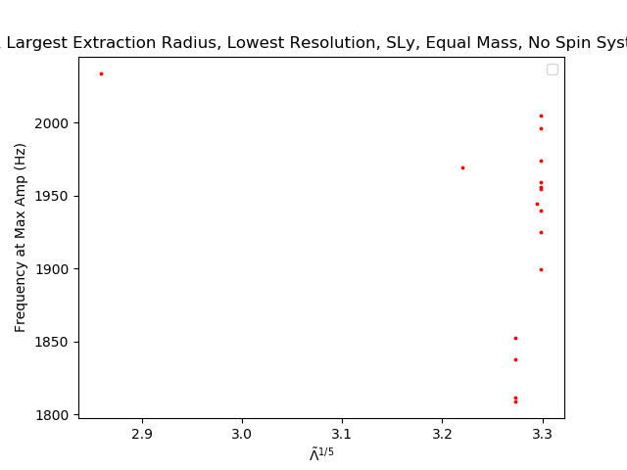
Duplicity in Combined Deformability and Fpeak

Slide 16
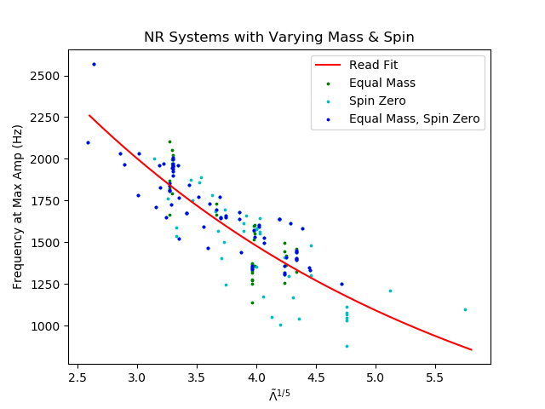
Read’s Fit w/ Read’s Parameters e.g. Equal Mass, Zero Spin, NR

Slide 17
SEOBNRv4T vs TEOBResum
SEOB:
Spins aligned
Recommended -0.5 to 0.5, q from 1 to 3
Tidal effects
TEOB:
No Spins
Tidal effects
Any q
Lambda from 50 to 5000
Other Notes:
There 347 files in CoRe database
Only 166 of these are non-degenerate. E.g. are not the same parameter set.
Try scipy curve fit for fittings
Update TEOB/SEOB plot for non-degeneracy in NR files.

Slide 18
Update
3/7/19

Slide 19
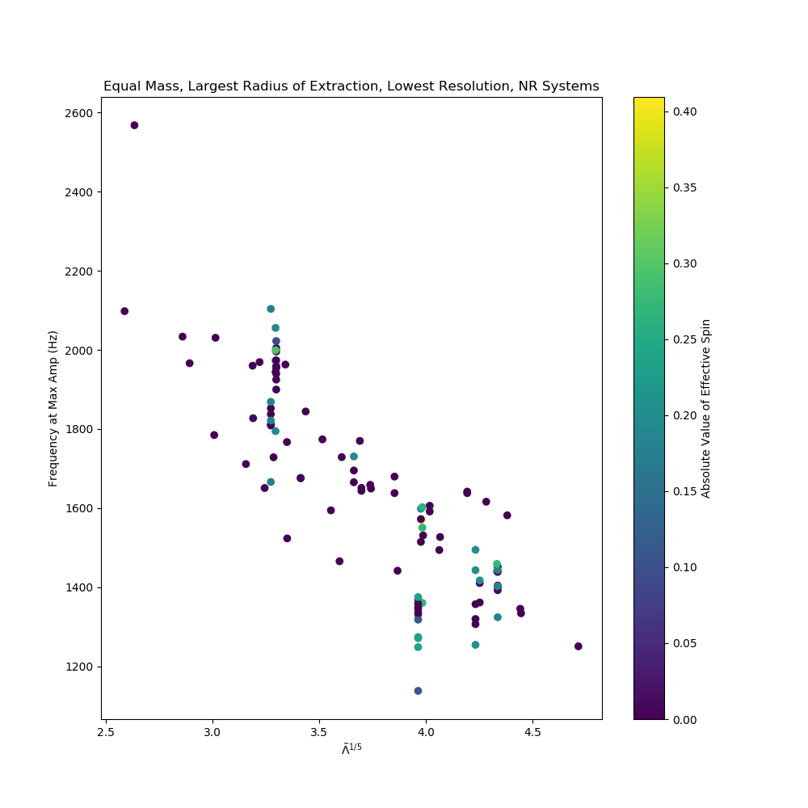
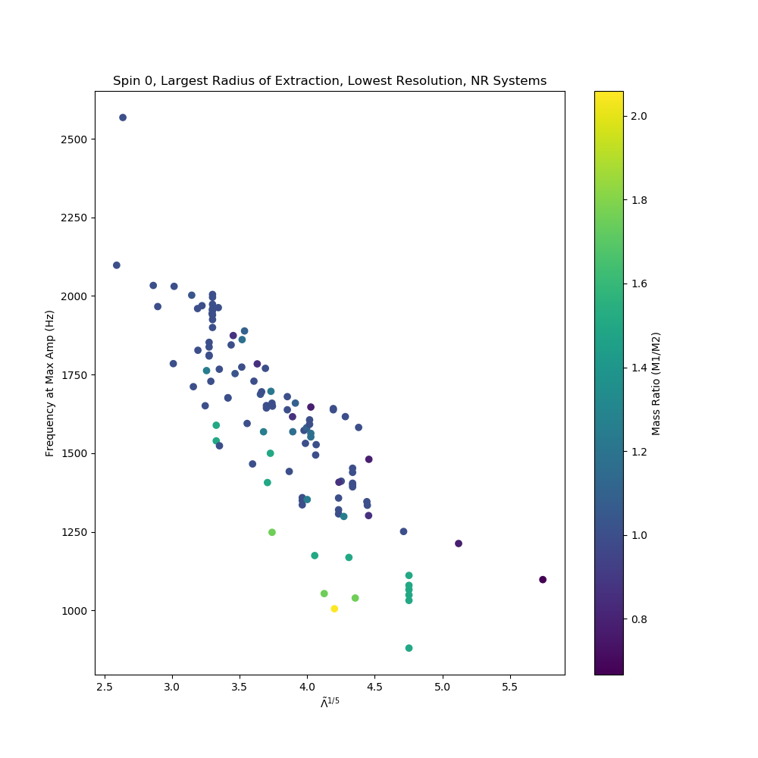
Equal Mass vs Zero Spin

Slide 20
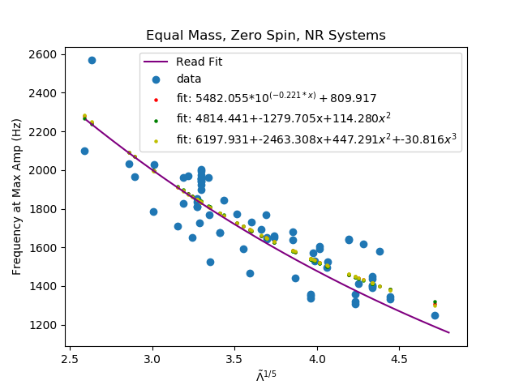
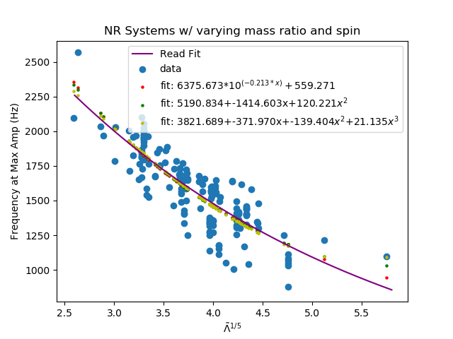
New Fits w/ Read’s Parameters

Slide 21
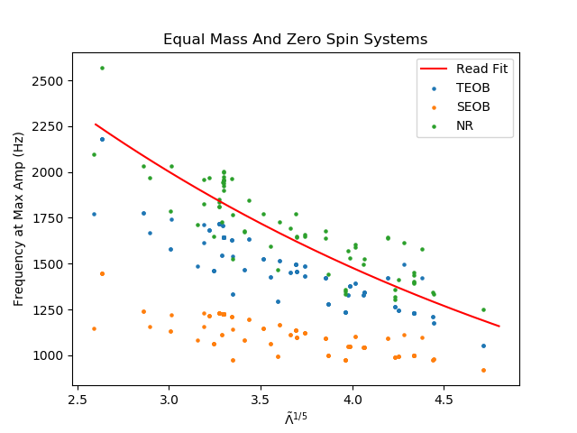
Fits w/ EOB and TEOB

